Slide 1
Lab 3
Buffer Overflow Vulnerability Lab
* The Lab #3 will NOT be graded.
Notes:
Hello and welcome to today’s lab class. This is Lab 3, and it will NOT be graded.
For any ungraded lab, you don’t have to submit anything. However, I strongly encourage everyone to attempt these ungraded labs. You will have lots of fun when practicing them.
Nonetheless, in this lab, you will have bonus marks by solving a Capture the Flag (CTF) challenge.
If you solve challenge, I will add 2 marks to your final grade (not above 100).
In Lab 3, you are going to write exploits which will break into an insecure program which is vulnerable to buffer-overflow attack.

Slide 2

Disclaimer
Information provided here and all in-class demonstrations are designed for the purpose of education, but not for any illegal activities.
Use of information security tools requires utmost ethical conduct.
Notes:
Before I procced, I would like to make some disclaimer here.
Information provided in this class and all in-class demonstrations are designed for the purpose of education, but not for any illegal activities. Also, use of information security tools requires utmost ethical conduct.
To defend a computer system you need to be able to think like an attacker, and that includes understanding techniques that can be used to compromise security. However, using those techniques in the real world may violate the law and the university's computing practices, or may be unethical. You must respect the privacy and property rights of others at all times, or else you will fail the course.
As cybersecurity professionals, you are required to adhere to the highest ethical standards of behavior.

Slide 3
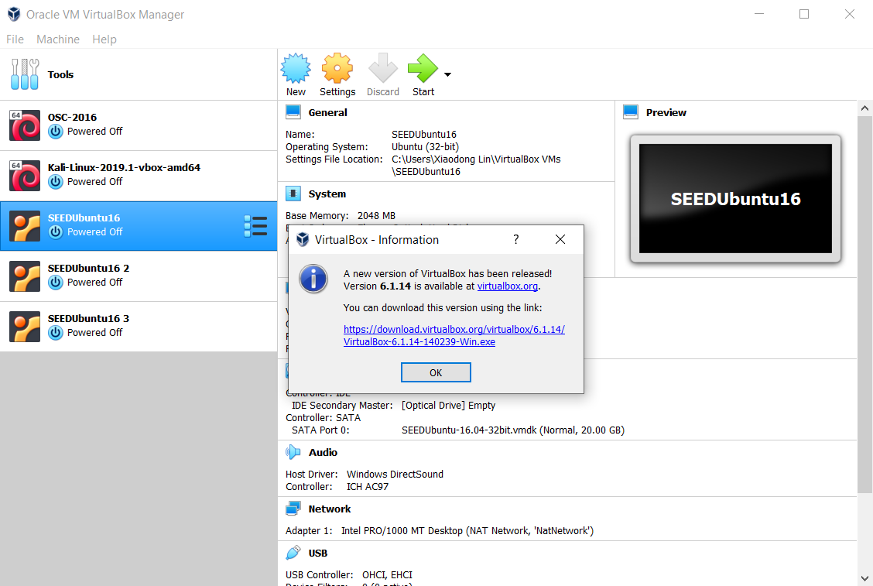
Don't update your VirtualBox now!
Notes:
Now we come back to the technical perspective of cybersecurity again.
You may be advised with a new version of VirtualBox becoming available. Please don't update your VirtualBox until you are done CIS4510. This avoids unnecessary reconfigurations and sometimes even worse reinstalling your VMs.

Slide 4
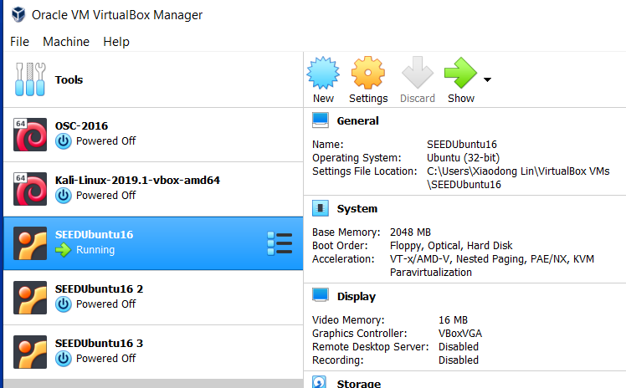
Start one VM only!
Notes:
For Lab 3, we need only one VM.

Slide 5

Buffer Overflow
Notes:
Lab 3 will be focused on buffer overflow vulnerability.

Slide 6
Buffer Overflow/Buffer Overrun
A buffer overflow, also known as a buffer overrun, is defined as follows^{[1]}:
“A condition at an interface under which more input can be placed into a buffer or data holding area than the capacity allocated, overwriting other information. Attackers exploit such a condition to crash a system or to insert specially crafted code that allows them to gain control of the system.”
DoS
compromising a computer (break into it or crack it without authorization.)
[1] Glossary of Key Information Security Terms.
https://www.nist.gov/publications/glossary-key-information-security-terms-2
Notes:
What is buffer overflow? A buffer overflow , also known as a buffer overrun , is defined in the NIST Glossary
of Key Information Security Terms as follows:
Buffer Overrun A condition at an interface under which more input can be placed into a buffer or data holding area than the capacity allocated, overwriting
other information. Attackers exploit such a condition to crash a system or to insert specially crafted code that allows them to gain control of the system.
From the above definition, you can see that the attacker can crash the vulnerable program (which is DoS attack) or execute the injected malicious code, which could take control of a system.

Slide 7
Stack Buffer Overflow
Notes:
There are mainly two types of buffer overflow, stack buffer overflow and heap buffer overflow. In our class, we primarily focus on stack buffer overflow.

Slide 8
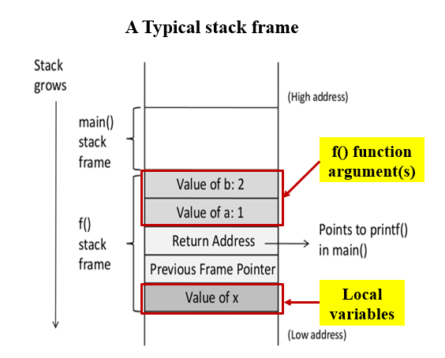

Stack Buffer Overflows
Occur when buffer is located on stack
  Also referred to as stack smashing^{[1]}
  Used by Morris Worm
  Exploits included an unchecked buffer overflow
Are still being widely exploited^{[2,3]}
Stack frame
  When one function calls another it needs somewhere to save the return address
  Also needs locations to save the parameters to be passed in to the called function and to possibly save register values
[1] Aleph One. "Smashing the Stack for Fun and Profit".
http://phrack.org/issues/49/14.html#article
[2] Matthias Vallentin. On the Evolution of Buffer Overflows
[3] K. Alharbi, X. Lin. Preventing stack buffer overflow attacks. US9251373B2
Notes:
When a function is called, a stack frame will be created to store the arguments given to the function, the function's local variables, and the return address so
when the function is finished, the program knows where to resume in the caller function.
A stack buffer overflow occurs when the targeted buffer is located on the stack, usually as a local variable in a function’s stack frame. This form of attack is also referred to
as stack smashing . Stack buffer overflow attacks have been exploited since first being seen in the wild in the Morris Internet Worm in 1988.
You will be amazed that stack buffer overflows are still being widely exploited now, as new vulnerabilities continue to be discovered in widely deployed software.
To better understand how buffer overflows work, we first take a brief digression into the mechanisms used by program functions to manage their local state on each call. When one function calls another, at the very least it needs somewhere to save the return address so the called function can return control when it finishes. Aside from that, it also needs locations to save the parameters to be passed in to the called function and also possibly to save register values that it wishes to continue using when the called function returns. All of these data are usually saved on the stack in a structure known as a stack frame . The called function also needs locations to save its local variables.
In C programming language, local variables are also stored in the function’s stack frame. One further piece of information then needed is some means of chaining
these frames together, so that as a function is exiting it can restore the stack frame for the calling function before transferring control to the return address.
The return address is also found in the stack frame.

Slide 9
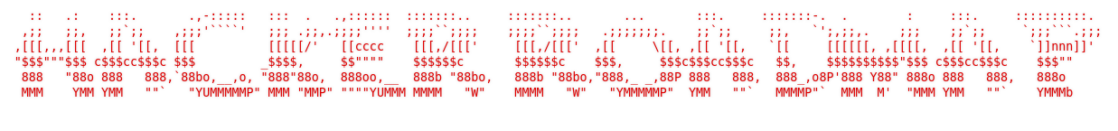
From DoS to compromising a computer (break into it or crack it without authorization.)
Notes:
In this lab, we will practice an attacking strategy starting with an easy mission (or crash the vulnerable program) and then moving on to take control of the system by compromising the vulnerable program, particularly injecting some malicious code (or shellcode) and getting a root shell.

Slide 10
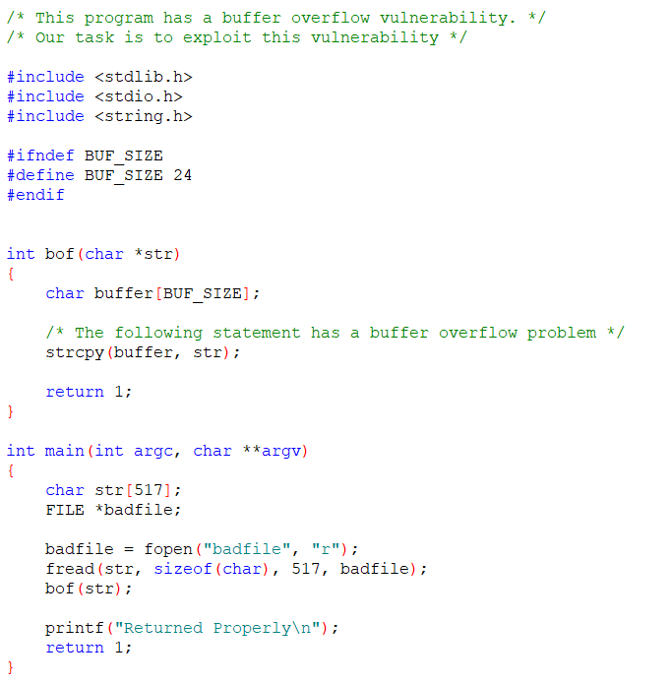

vulnerable to buffer overflow
Notes:
This is the program we will attack.
Please be advised that by default, the buffer size is set as 24 characters. This is for Lab Section 1. If you are in Lab section 2, you will need to change it to 36. You are attacking the program with the buffer size of 36 characters.
You can see that this program is vulnerable to buffer overflow. Particularly, in the statement “strcpy(buffer, str);”. It tries to copy the content of str to the buffer. But the buffer only has the size of 24 or 36 characters. What if the str has more than 24 o3 36 characters, it overflows the buffer. Unfortunately, this is the case since the content of the str is from a file called badfile, which has 517 characters.

Slide 11
Exercise 1: Exploiting the Vulnerability by launching DoS attack
Notes:
First, we try DoS attack. In other words, we try to crash the vulnerable program. Find a way to crash the program.

Slide 12

Crash the vulnerable program
Environment Setup
gcc -z execstack -fno-stack-protector -o stack stack.c
Crash the vulnerable program
Notes:
Like I mentioned in the beginning of my class, sometime computer security theory is straightforward and easy to understand, but it becomes
Very challenging when we try to implement them and make them happen.
Next, let us do it together, getting our hands dirty a little bit. Now I want you to start your VM and walk through the followings together. If you don’t have your computer /laptop with you, it is ok. You can still learn something when your classmates give their results.
Then, download required files from CIS4510 course website.
If you look at foo() function. We are copying a string from the function argument into a buffer of size 24 bytes (or 36 bytes for Lab section 2). This could lead to buffer overflow since the source string is from a file called badfile. We read up to 517 bytes, which have more than 24 characters. As such, the program is vulnerable to buffer overflow.
Now, I will ask you to compile the program and type
gcc -z execstack -fno-stack-protector -o stack2 stack.c
Then, try to run the executable many times by creating different badfile files to see if you are able to crash the program.

Slide 13
Crash the vulnerable program (cont’d)
Environment Setup
gcc -z execstack -fno-stack-protector -o stack stack.c
Crash the vulnerable program
touch badfile
echo "I am a badfile" > badfile
echo $(printf "\x11\x22\x33\x44")_A_B_C_D_E > badfile
Using the head command and /dev/urandom to create the badfile with random data. For example,
head -c 517 </dev/urandom >badfile
Notes:
There are many different ways to create a file, for example,
Using the touch command to create the badfile file, but without any content. The touch command is a standard command used in UNIX/Linux operating system which is used to create, change and modify timestamps of a file.
Using the echo command and redirect its output to the badfile
Using any programming language that you are familiar with, for example, using shell
Or, using the head command and /dev/urandom to create the badfile with random data.
The head command is a command-line utility for outputting the first part of files given to it via standard input.
/dev/urandom is a special file in Linux that serves as a pseudorandom number generator.
For example, create a file named badfile of size 517 bytes with random data.
We use /dev/urandom to generate random data which then is input into The head command using input redirect. Afterwards, we only take the first 517 chacacters and save them into the badfile using out redirect.
head -c 517 </dev/urandom >badfile

Slide 14
Exercise 2: Exploiting the Vulnerability by launching privilege escalation attack
Notes:
Second, we try to take control of the system by compromising the vulnerable program, particularly injecting some malicious code (or shellcode) and getting a root shell. Now it becomes a little challenging.

Slide 15
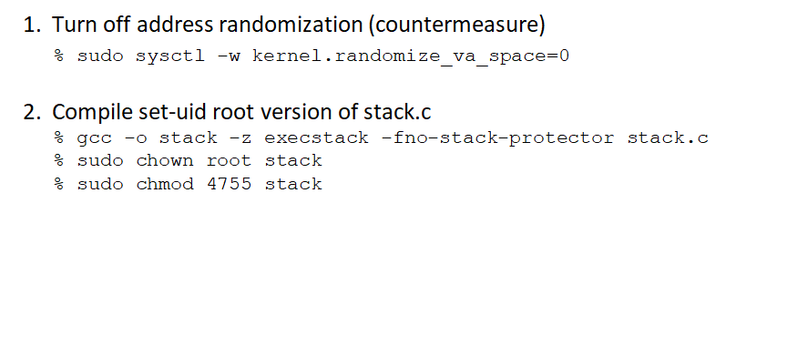
Environment Setup
Disable stack guard protection
Executable stack
add setuid permission to stack
Turn off protection mechanisms temporarily!
change the owner of stack to root
Notes:
To perform this attack, we need to first switch off the countermeasures.
Address randomization is turned off so that the base address of the buffer remains. It makes the task simpler to guess the return address in the stack.
We set the stack as executable as we need to execute our own code on the stack. Also, we disabled stack guard protection.
Last two commands are changing the properties of stack
1. change the owner of stack to root
2. add setuid permission to stack, which means anybody executing stack will inherit the permissions of the owner of stack, which is root. It will be discussed later.

Slide 16

Sample
Stack
Layout of a stack frame
H
888
Address of (y=3) as return address
saved frame pointer
x
y
buf[99]
……
Buf[0]
L
x=2;
foo(888);
y=3;
void foo(int j) {
int x,y;
char buf[100];
x=j;
}
Notes:
Next, let’s take a simple example to how a stack frame looks like after a c function is called. We define a c function foo().
When foo() is called, a stack frame will be created. First, the function argument (888 which is an integer) is first pushed onto the stack frame
Then, the return address (or the address of statement y=3) is saved onto the stack as well so we know where we return to after foo is finished.
Also, the old value of the frame pointer for the function which called foo() is saved onto the stack next.
Finally, the local variables of the foo() function (which include two integer variables and one character buffer) are pushed into the stack.

Slide 17
Before and After Stack Overflow
void foo(char *s) {
char buf[100];
strcpy(buf,s);
…
Before
After
address of s
address of s
return-address
pointer to pgm
(malicious)
Small Program
Stack
saved FP
buf
NOP instructions
Shellcode
NOP sled
Notes:
The figure on your left shows the stack frame before the buffer overflow attack.
The figure on your right shows the stack frame after the buffer overflow attack. Particularly, you inject some malicious code (or shellcode in our attack) into the stack through buffer overflow. Noe that in order to make the attack be reproduced quickly, we add some NOP (or “No Operation”) instructions before the malicious code, which is also known as NOP sled.
As such, as far as we are able to modify the return address pointing to any where in NOP sled. The attack will be successful.

Slide 18

Setuid root applications
The passwd utility (or whatever you used) is automatically given root privilege when executed, no matter who invoked it. In Unix parlance, it is called a set-user or setuid program because it the privileges of the process are automatically set to those of another user, root in this case.
  What if passwd utility has buffer overflow vulnerability, which is exploited by someone and used to launch a shell?
Notes:
Next, we need to review the setuid concept.
The concept of setuid allows user to run a program with the program owner’s privilege. What if the owner of a program is root.
So we talk about Setuid root applications, it means these applications will have root privileges when executing.
This is a very important feature in Linux, and it allows users to run programs with temporary elevated privileges
Example: the passwd utility can be used to modify a user’s password.
As you know, the password is stored in the /etc/shadow file, which can be only accessible to the root.
Which means a regular user must modify the /etc/shadow file. So the solution is turning on the set-uid permission on the passwd utility which is owned by the root.
The passwd utility is automatically given root privilege when executed, no matter who invoked it.
While this feature is wonderful, but it also comes with a big issue. What if passwd utility has buffer overflow vulnerability, which is exploited by someone and used to launch a shell? This will be a root shell. So the attacker takes control of your computer completely. This is the attacking scenario we are doing today.

Slide 19




Setuid root programs
unprivileged user
Buffer overflow
exploit
Privilege Escalation Attack
launch
Root shell
Set-UID program
Notes:
Now we put everything together to illustrate the attack we have walk through.
An attacker, a normal user, discover a set-uid program owned by root, called stack, is vulnerable to buffer overflow.
Since the stack is a set-uid program owned by root, it is automatically given root privilege when executed, no matter who invoked it including the attacker.
So the attacker carefully develops a buffer overflow exploit and launch a successful buffer overflow attack. In the end, the attacker gets a root shell.
This type of attack is called privilege escalation attack.

Slide 20
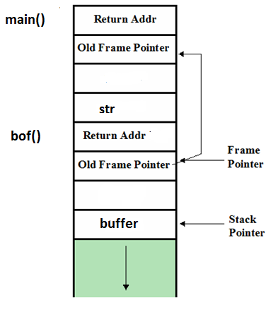
[ebp] points to the location of the old value of ebp, [ebp + 4] points to the return address, and [ebp + 8] points to the first function argument.
/* stack.c - Stack-based buffer overflow example */
/* This program has a buffer overflow vulnerability. */
/* Our task is to exploit this vulnerability */
#include <stdlib.h>
#include <stdio.h>
#include <string.h>
int bof(char *str)
{
char buffer[24];
/* The following statement has a buffer overflow problem */
strcpy(buffer, str);
return 1;
}
int main(int argc, char **argv)
{
char str[517];
FILE *badfile;
badfile = fopen("badfile", "r");
fread(str, sizeof(char), 517, badfile);
bof(str);
printf("Returned Properly\n");
return 1;
}
ebp register (Base Pointer)
Where does buffer start?
gcc -z execstack -fno-stack-protector -g -o stack_dbg stack.c
Notes:
In order to make the attack happen, you will need to figure out some important information, which is labelled as task 1 in Lab 3.
Particularly, you will need to find out the memory location where the return address is stored. Specifically, you need to find out the distance between the start of the buffer (which you will overflow it) and the memory location storing the return address. In other words, you have to know the memory address of the beginning of the buffer and the value of the frame pointer register ebp.
Remember the frame pointer register ebp is the base pointer for the current stack frame, pointing to the location where the old value of ebp (or the value of EBP from the function that called the current function) is stired, [ebp + 4] points to the return address. Note that each address is 32-bits or 4bytes.

Slide 21


gdb
Compile the C program with debugging option -g
Launch gdb
gdb stack_gdb
Set up a break point inside C program
e.g., b bof
Execute the C program in gdb debugger
run
Printing important info inside gdb debugger
(gdb) p &buffer or (gdb) p &buffer[0]
(gdb) p $ebp
Notes:
Now we need to ask our friend to help out. gdb is your friend.
First, compile the C program with debugging option -g
Afterwards, launch gdb and set up a break point inside C program.
For example, you set a set breakpoint on function bof. So gdb will stop your program just before the bof function starts to run.
Then, execute the C program in gdb debugger using the run command
Once you executed the C program, it would execute until the first break point.
Note that the next statement to execute is “strcpy(buffer, str);”, which is the first statement in the bof function.
Now you can print the address of the variables (particularly the address of the start of the buffer) as well as their values inside gdb debugger
Also, you can print the value of the register ebp, which is the base pointer for the current stack frame.

Slide 22

/* exploit.c */
/* A program that creates a file containing code for launching shell*/
#include <stdlib.h>
#include <stdio.h>
#include <string.h>
char shellcode[]=
"\x31\xc0" /* xorl %eax,%eax */
"\x50" /* pushl %eax */
"\x68""/zsh" /* pushl $0x68732f2f */
"\x68""/bin" /* pushl $0x6e69622f */
"\x89\xe3" /* movl %esp,%ebx */
"\x50" /* pushl %eax */
"\x53" /* pushl %ebx */
"\x89\xe1" /* movl %esp,%ecx */
"\x99" /* cdq */
"\xb0\x0b" /* movb $0x0b,%al */
"\xcd\x80" /* int $0x80 */
;
Notes:
Now we come to our most fun part of Lab 3. In this lab, you are to write exploits based on skeleton source given, and it is called exploit.c. So you can create a right badfile and break into the insecure program which is vulnerable to buffer-overflow attack.

Slide 23
void main(int argc, char **argv)
{
char buffer[517];
FILE *badfile;
/* Initialize buffer with 0x90 (NOP instruction) */
memset(&buffer, 0x90, 517);
/* You need to fill the buffer with appropriate contents here */
//Task 1: Set the value for the new return address
*((long *) (buffer + _______)) = ___________;
//Task 2: Place the shellcode towards the end of buffer
  ……
/* Save the contents to the file "badfile" */
badfile = fopen("./badfile", "w");
fwrite(buffer, 517, 1, badfile);
fclose(badfile);
}
Notes:
Specifically, you will need to accomplish two tasks using the information you discovered using gdb.
Task 1: Set the value for the new return address
Task 2: Place the shellcode towards the end of buffer

Slide 24
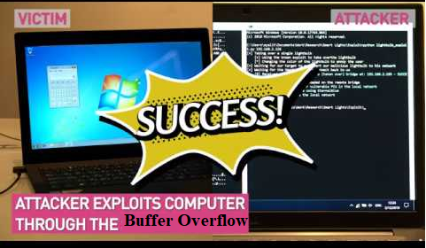
Attack
$ gcc -o exploit exploit.c
$ ./exploit // create the badfile
$ ./stack // launch the attack by running the vulnerable program
# <---- Bingo! You’ve got a root shell!
Notes:
After you are done, you can launch the attack. First, you complie the exploit you have completed and developed, and execute it to create the badfile. Then, you launch the attack by running the vulnerable program. If your attack is successful, you should get a root shell. Bingo!

Slide 25
Exercise 3: Defeat Protection
Notes:
Next, we would like to try to defeat some protection in today’s modern operating systems.

Slide 26
ASLR
Typically, a buffer overflow exploit overwrites a return address so that a function will return to an attacker-chosen address. ASLR makes it difficult for the attacker to find an address to jump to.
$ sudo /sbin/sysctl -w kernel.randomize_va_space=1
Defeat It!
Notes:
Typically, a buffer overflow exploit overwrites a return address so that a function will return to an attacker-chosen address. ASLR makes it difficult for the attacker to find an address to jump to.
Unfortunately, on 32-bit Linux machines, the possible locations for a stack is limited, and the space is not very big, and can be exhausted easily with the brute-force approach. In this task, we use such an approach to defeat the address randomization countermeasure on our 32-bit VM.
for simplicity, we only turn on the basic level (1 (enabled)) of Address Randomization.

Slide 27

Generate Your Lucky Numbers
lucky.c
Notes:
Finally, I have a fun exercise for you. Let’s catch the flag. It is a game for hack. For this question, you will try your best to generate your lucky number.
You are given a c program called lucky.c. It takes a password as input, but always refuses to generate a lucky number. Luckily, the program is vulnerable to buffer overflow attack. The goal is to take advantage of the vulnerability so that it can generate lucky numbers for us.

